Slide 1
Your Assignments for the Profiling Exercise
Group # | Members of the Group |  |  |  |  |  |  | Country
Group 1 | 202294001 | 202230049 | 202203037 | 202201059 | 202130013 | 202109054 | 202102122 202106111 | Japan
Group 2 | 202292026 | 202230001 | 202203017 | 202121060 | 202130004 | 202109038 | 202102118 | India
Group 3 | 202242065 | 202225024 | 202202396 | 202157027 | 202121021 | 202109037 | 202101158 | United Kingdom
Group 4 | 202231011 | 202220108 | 202202341 | 202142066 | 202120118 | 202106064 | 202101133 | Russian Federation
Group 5 | 202231008 | 202209101 | 202202247 | 202142029 | 202117019 | 202106026 | 202101093 | Canada
Group 6 | 202230097 | 202209034 | 202202045 | 202142002 | 202116029 | 202103024 | 202016020 | Brazil
Group 7 | 202230091 | 202209005 | 202201083 | 202130029 | 202116007 | 202102137 | 202006286 | Australia
Notes:
Deep Dive: Public Procurement
Day Two Presentation

Slide 2
Absolute Advantage and Comparative Advantage
Craig VanGrasstek

Slide 3
Our Sequence: Practice, then Theory

Slide 4
Team Assignments
Negotiation 1
La Finca | 202294001, 202292026, 202242065
Patagonia | 202231011, 202231008, 202230097
Negotiation 2
La Finca | 202230091, 202230049, 202230001
Patagonia | 202225024, 202220108, 202209101
Negotiation 3
La Finca | 202209034, 202209005, 202203037
Patagonia | 202203017, 202202396, 202202341
Negotiation 4
La Finca | 202202247, 202202045, 202201083
Patagonia | 202201059, 202121060, 202157027
Negotiation 5
La Finca | 202142066, 202142029, 202142002
Patagonia | 202130029, 202130013, 202130004
Negotiation 6
La Finca | 202121021, 202120118, 202117019
Patagonia | 202116029, 202116007, 202109054
Negotiation 7
La Finca | 202109038, 202109037, 202106064
Patagonia | 202106026, 202103024, 202102137
Negotiation 8
La Finca | 202102122, 202102118, 202101158, 202106111
Patagonia | 202101133, 202101093, 202016020, 202006286

Slide 5
Team Assignments
Negotiation 1
La Finca | 202294001, 202292026, 202242065
Patagonia | 202231011, 202231008, 202230097
Negotiation 2
La Finca | 202230091, 202230049, 202230001
Patagonia | 202225024, 202220108, 202209101
Negotiation 3
La Finca | 202209034, 202209005, 202203037
Patagonia | 202203017, 202202396, 202202341
Negotiation 4
La Finca | 202202247, 202202045, 202201083
Patagonia | 202201059, 202121060, 202157027
Negotiation 5
La Finca | 202142066, 202142029, 202142002
Patagonia | 202130029, 202130013, 202130004
Negotiation 6
La Finca | 202121021, 202120118, 202117019
Patagonia | 202116029, 202116007, 202109054
Negotiation 7
La Finca | 202109038, 202109037, 202106064
Patagonia | 202106026, 202103024, 202102137
Negotiation 8
La Finca | 202102122, 202102118, 202101158, 202106111
Patagonia | 202101133, 202101093, 202016020, 202006286

Slide 6
Imagine a Simplified World
There are just two countries (Pantalonia and La Finca) of identical population size
They produce, consume, and trade only clothing and food, with no qualitative differences between these goods.
There being only two products, the countries can trade by barter (i.e., there is no money or exchange rates).
Transportation costs and other transaction costs are zero.
The returns to scale are constant, with no frictional costs in moving from the production of one good to another.

Slide 7
The Production Possibilities for Pantalonia
In autarchy, Pantalonia divides its productive resources evenly between these two sectors
It produces and consumes 25 units of food and 25 units of clothing
In trade, it can reallocate its resources to any of these possibilities
The citizenry insists that any exchange with La Finca must result in no net loss of food or clothing
 | Food | Clothing
Only Food | 50 | —
90% Food | 45 | 5
80% Food | 40 | 10
70% Food | 35 | 15
60% Food | 30 | 20
50-50% | 25 | 25
60% Clothing | 20 | 30
70% Clothing | 15 | 35
80% Clothing | 10 | 40
90% Clothing | 5 | 45
Only Clothing | — | 50

Slide 8
The Production Possibilities for La Finca
In autarchy, La Finca divides its productive resources evenly between these two sectors
It produces and consumes 60 units of food and 40 units of clothing
In trade, it can reallocate its resources to any of these possibilities
The citizenry insists that any exchange with Pantalonia must result in no net loss of food or clothing
 | Food | Clothing
Only Food | 120 | —
90% Food | 108 | 8
80% Food | 96 | 16
70% Food | 84 | 24
60% Food | 72 | 32
50-50% | 60 | 40
60% Clothing | 48 | 48
70% Clothing | 36 | 56
80% Clothing | 24 | 64
90% Clothing | 12 | 72
Only Clothing | — | 80

Slide 9
Your Deal Must Meet the Following Conditions
The total amount of food produced in this two-country world must equal or exceed the 85 units produced in autarchy
Total production of clothing must equal or exceed 65 units
Pantalonia’s consumption of food — the amount that it produces and retains, plus the amount that it receives from La Finca — must equal or exceed 25 units
Pantalonia’s consumption of clothing must equal or exceed 25 units
La Finca’s consumption of food must equal or exceed 60 units
La Finca’s consumption of clothing must equal or exceed 40 units

Slide 10
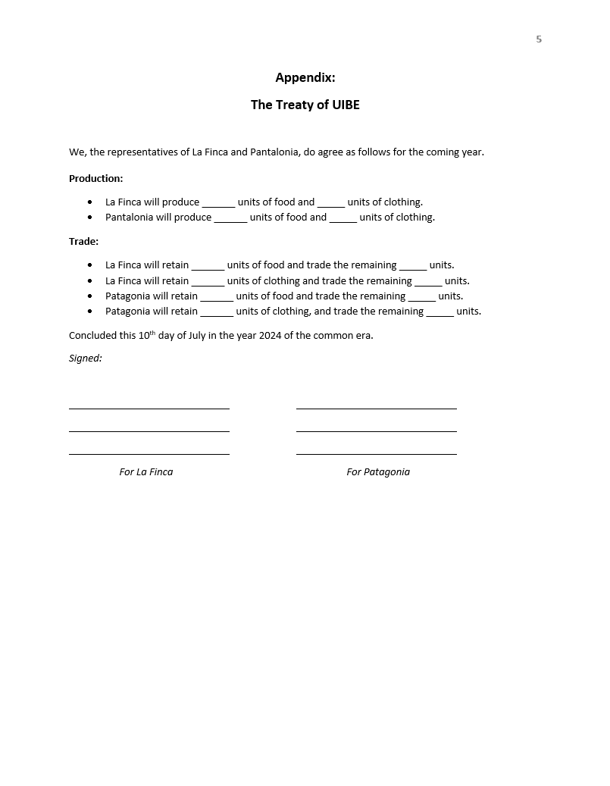
Use the Draft Treaty Both in Your Proposals to the Other Team and for the Final Deal that You Reach
As soon as you reach a final agreement, submit the signed treaty to the instructor. Stay in the room.
If you do not reach an agreement by the deadline, turn in your paper and declare your negotiation a failure.
Add the Negotiation Number Here (1, 2, 3, etc.)

Slide 11
What is at stake in this game?

Slide 12
Greatest
Gains in
Welfare

Slide 13
Teams should spend about 15 minutes to calculate the possibilities and develop proposals.
Keep track of where your partners are, and start negotiating as soon as you can.
We will a deadline for when you must finish. By then you should either (1) sign and submit the treaty, or (2) tell me that you have failed.

Slide 14
Good luck!

Slide 15
Topic 2: Debrief on the Results of Your Negotiations

Slide 16
A Summary of the Problem and Its Solution(s): How to Produce a Win-Win Result for the Partners
The overall constraints:
For both countries to be made whole, the world needs 85 units of food and 65 units of clothing.
If Pantalonia specializes entirely in clothing (where it is at the least disadvantage) the 50 units that it produces will require that La Finca produce at least 85 units of food and at least 15 units of clothing.
Creating value (two alternatives):
If La Finca devotes 75% of its resources to food, thus producing 90 food and 20 clothing, the world will have 5.9% more food than it did in autarchy, and 7.7% more clothing (or 6.7% more total welfare).
If La Finca devotes 80% of its resources to food, thus producing 96 food and 16 clothing, the world will have 12.9% more food than it did in autarchy, and 1.5% more clothing (or 8.0% more total welfare).
Claiming value:
Under the 75% allocation, La Finca can trade ≤30 food to get the ≥20 clothing that it needs.
Under the 80% allocation, La Finca can trade ≤36 food to get the ≥24 clothing that it needs.
Under the 100% allocation, Pantalonia can trade ≤25 clothing to get the ≥25 food that it needs.
There are numerous rates of exchange by which both partners can be better off post-trade.

Slide 17
So Now Let’s Calculate How Much Each Country Consumes Once They Trade with One Another
For each country and product, consumption equals what it retained plus what the other country traded. For example,
La Finca’s consumption of food equals the value of food that it retained plus the value of food that Pantalonia traded (red rectangles);
Pantalonia’s consumption of clothing equals the value of clothing that it retained plus the value of clothing that Pantalonia traded (blue rectangles);
Etc., etc.

Slide 18
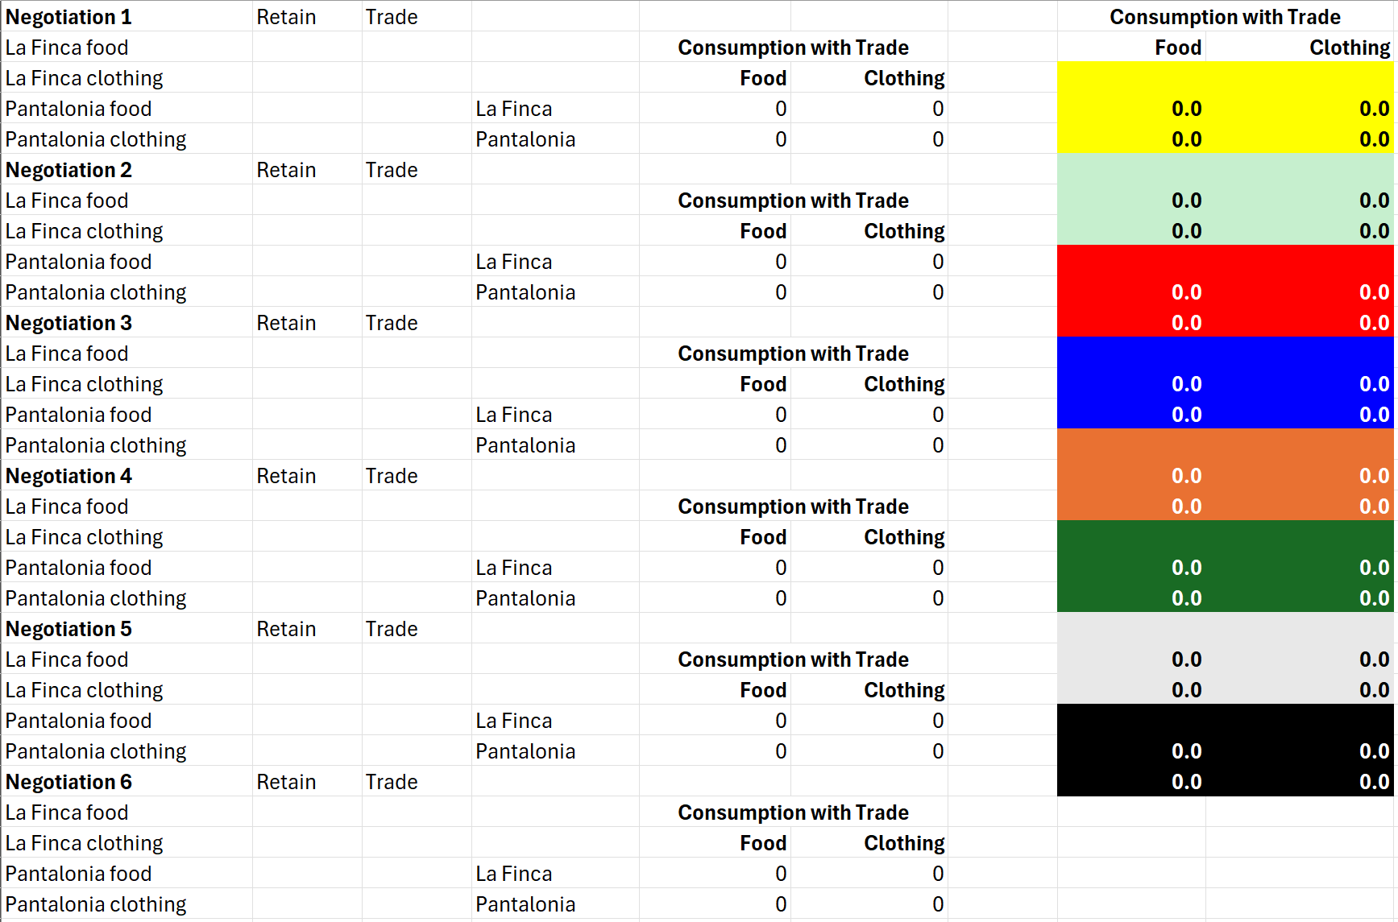
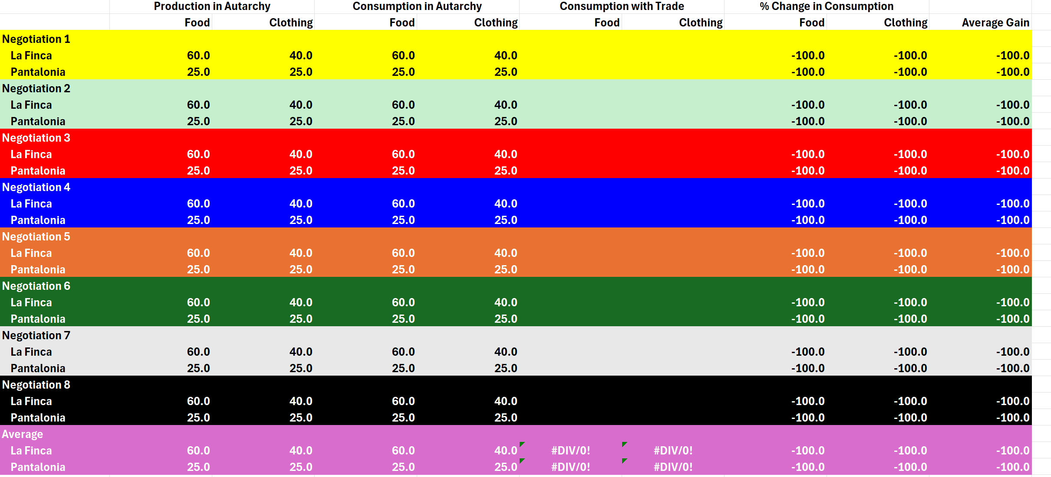
This Lets Us Calculate Changes in Welfare
We Will Simply Equate Welfare with Consumption

Slide 19
Greatest
Gains in
Welfare

Slide 20
Additional Debrief Questions
You should now appreciate how the theory of comparative advantage demonstrates that even a country that is uncompetitive across-the-board can be better off with trade than it was under autarchy. That said, consider some complicating factors:
Can you see how the desire to get the better of a deal, or to achieve a result that appears fair to both parties, may result in no deal at all?
In the real world, would farmers and apparel workers eagerly change professions?
In the best outcome, Pantalonia will depend entirely on La Finca for its food. Is there any problem with this result?
What should be the impact over time of technological changes on these exchanges? Does the case for freer trade become more or less persuasive when we bring back in transportation costs, and when we factor in their long-term decline?

Slide 21
Topic 3: Three Phases in How the Gains from Trade Are Conceived

Slide 22
Phase I: The Mercantilist Theory of Trade (No single author or text)
Trade is the conduct of war by other means:
Wealth = Specie (precious metals)
Specie is zero-sum, as are the gains from trade.
Specie is obtained through trade surpluses.
This wealth is convertible into power by building ships, hiring mercenaries, etc.
Countries have no incentive to liberalize trade with adversaries (but may reach special deals with their allies or clients).
Is mercantilism really dead?

Slide 23
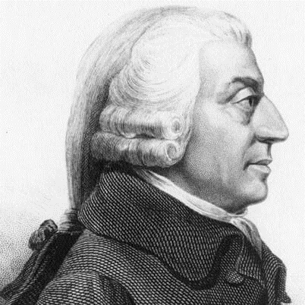
Phase II: Adam Smith’s Concept of Absolute Advantage An Inquiry into the Nature and Causes of the Wealth of Nations (1776)
Wealth is not money, but instead a country’s productivity.
Productivity can be enhanced through the division of labor.
That division of labor is best pursued at the global level.
All countries will gain if they concentrate on what they do best and import the items for which they are least competitive.

Slide 24
The Production Possibilities of La Finca and Pantalonia in Scenario 1
100
Units of Clothing
75
Production
Possibilities
of Pantalonia
50
Production
Possibilities
of La Finca
25
0
0
25
50
75
100
Units of Food

Slide 25
The Allocation of Resources by La Finca and Pantalonia in Autarchy
100
Units of Clothing
In autarchy, La Finca has 50 units of food and 25 of clothing, and Pantalonia has 25 food and 50 clothing.
What could they have with specialization and trade?
75
Production
Possibilities
of Pantalonia
50
Production
Possibilities
of La Finca
25
0
0
25
50
75
100
Units of Food

Slide 26
The Allocation of Resources by La Finca and Pantalonia in Trade
100
But what should a country do if it is not best at anything?
Units of Clothing
With complete specialization and trade, global food production rises from 75 (25+50) to 100, and global clothing production rises to the same degree, for a global welfare increase from 150 to 200 (+33.3%). Assuming that the two countries trade one-to-one, they will each experience that same level of increased welfare.
75
Production
Possibilities
of Pantalonia
50
Production
Possibilities
of La Finca
25
0
0
25
50
75
100
Units of Food

Slide 27
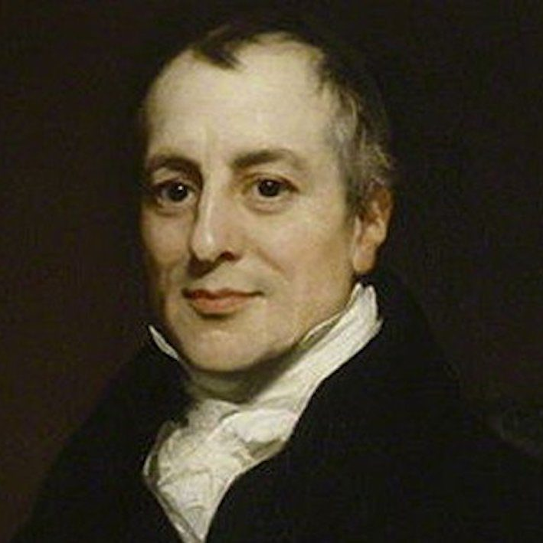
Phase III: David Ricardo’s Comparative Advantage On the Principles of Political Economy and Taxation (1817)
The gains from trade come not from absolute advantages between countries, but the reallocation of resources within a country that is facilitated by trade with others.
Each country will do better by concentrating on those goods in which it is comparatively more productive (or less unproductive).
Even uncompetitive countries can gain from trade with more competitive partners.

Slide 28
The Production Possibilities of La Finca and Pantalonia
100
For which of these products is Pantalonia at less of a disadvantage in comparison to La Finca?
Units of Clothing
75
Production
Possibilities
of La Finca
50
25
Production Possibilities of
Pantalonia
0
0
25
50
75
100
125
Units of Food

Slide 29
The Production Possibilities of La Finca and Pantalonia
100
Pantalonia’s productivity for clothing is 50/80 (62.5%) that of La Finca
75
Production
Possibilities
of La Finca
50
25
Production Possibilities of
Pantalonia
0
0
25
50
75
100
125
Pantalonia’s productivity for food is 50/120 (41.6%) that of La Finca

