Slide 1
Introduction: A Practical Guide to the International Trading System
Craig VanGrasstek

Slide 2
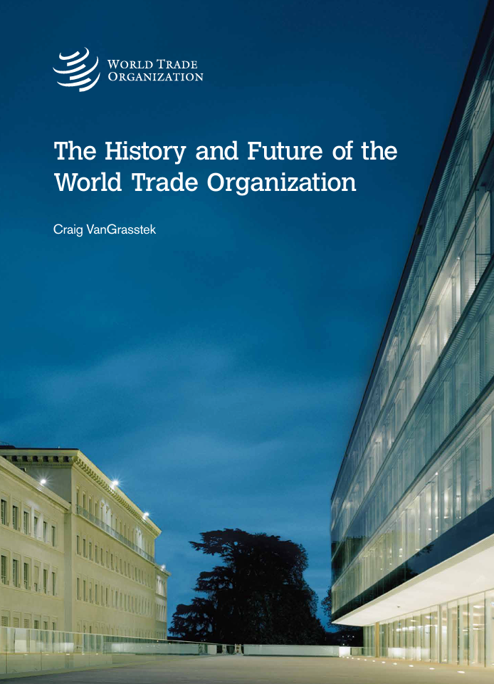
My Background
Academic
Not an economist or a lawyer, but a political scientist
Taught this subject since 1994
The History and Future of the World Trade Organization (2013)
Trade and American Leadership (2019)
Practical
Advised government and private clients since 1982
Advised China (and others) on WTO accession as well as many other practical issues

Slide 3
My Assumptions
Your Needs
I will assume that you aim for a career in business
Your main need is to understand how the operation of the trading system may affect your businesses
Beyond knowing the current rules, you should also know where they come from (how agreements are negotiated) and how disputes over the rules are settled
You should leave this class knowing where to find practical information and how to interpret it for use in business

Slide 4
My Expectations
Help Me Help You
Do the readings
Ask questions
Start working with your team on the practical exercise tomorrow; have it ready (printed) on our last day
Make sure you learn the concepts on the handout entitled “Key Facts and Terms in the Trading System”
Our next-to-last class will be an opportunity to raise any questions you want and/or to do a final review session for the examination

Slide 5
Your Two Principal Tasks
Profiling Exercise:
You will work in seven groups of seven
The scenario involves advising the CEO of a multinational corporation on countries’ policies
The exercise is built around using the ideas and skills covered in this class in a very practical, real-world way
Final Examination:
Key terms and ideas
Core skills

Slide 6
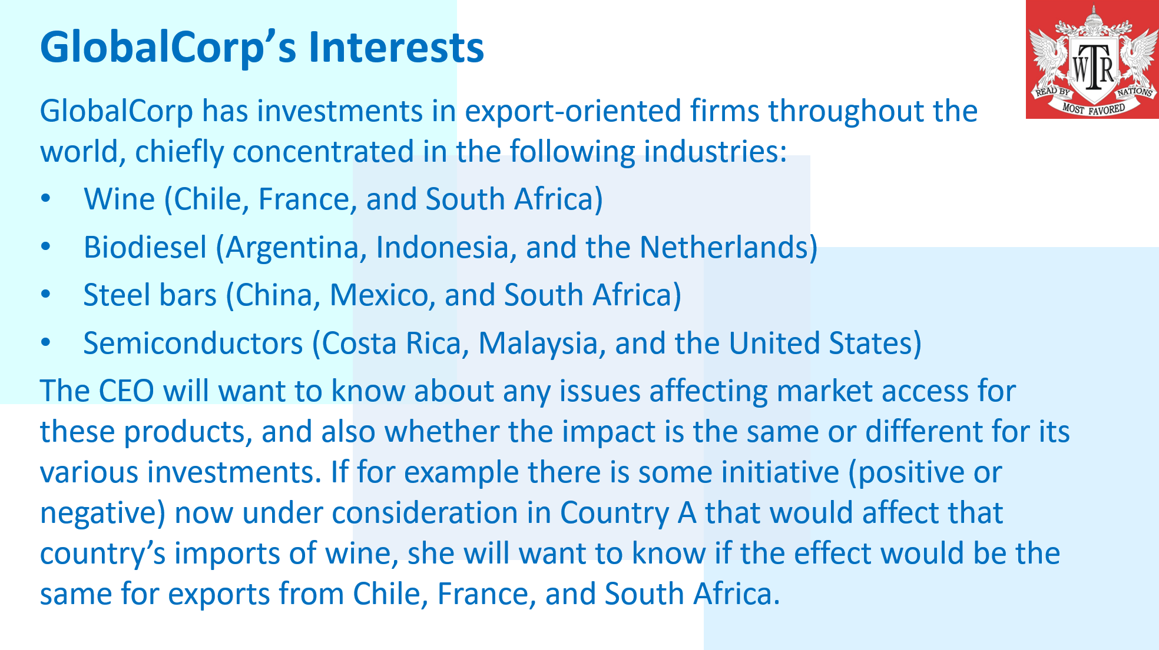
More on the Profiling Exercise

Slide 7
Key Terms to Learn

Slide 8
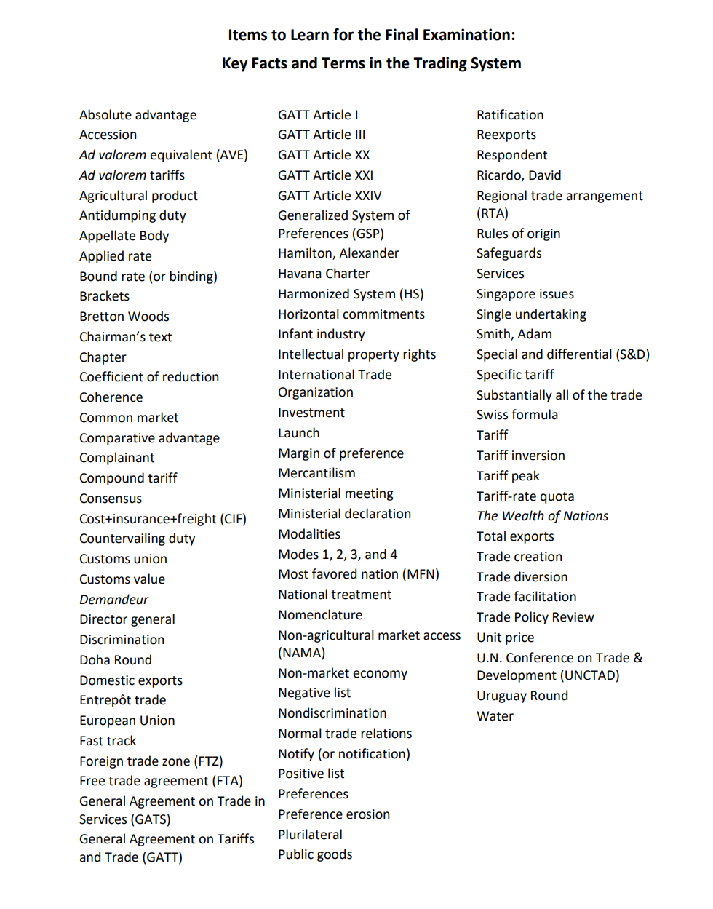
Let’s Highlight 7 for Now:
Agriculture
Comparative advantage
Consensus
Discrimination
Political
Public goods
And above all …
Trade

Slide 9
Trade

Slide 10
Agriculture

Slide 11
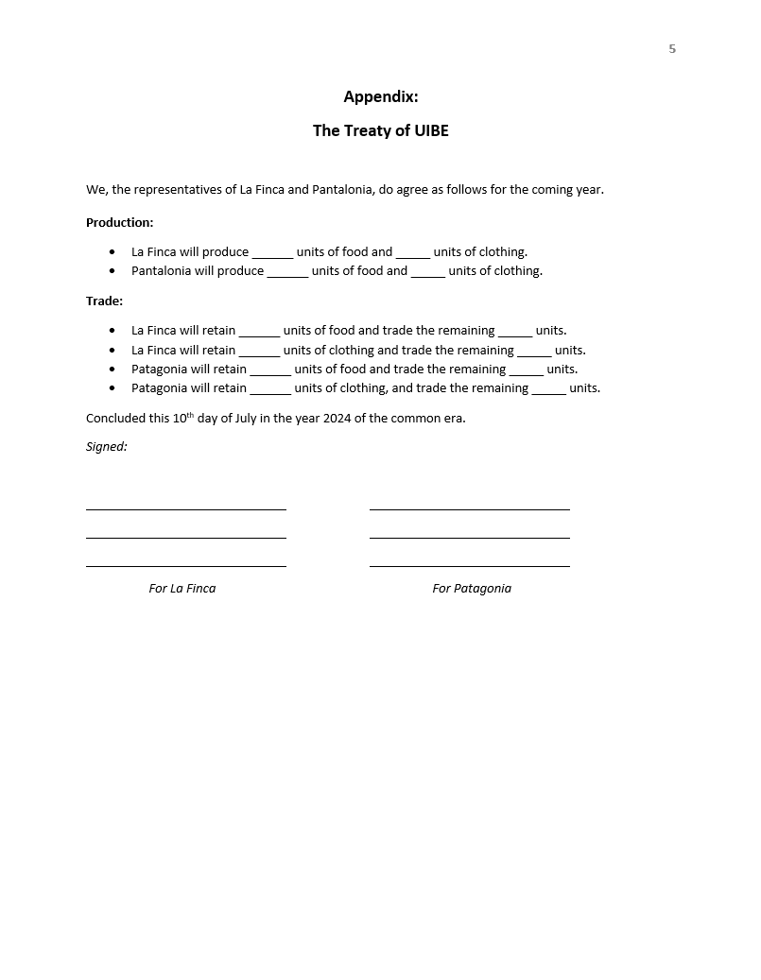
Comparative Advantage

Slide 12
Consensus

Slide 13
Discrimination (Preferences) and Nondiscrimination

Slide 14
Political
Think about this in advance of our next session.
We use the word “political” all the time, but what does it really mean? What is it that might distinguish something as a political perspective or issue, rather than (for example) one that is legal or economic?

Slide 15
Public Goods

Slide 16
What the Trading System Is and Is Not

Slide 17
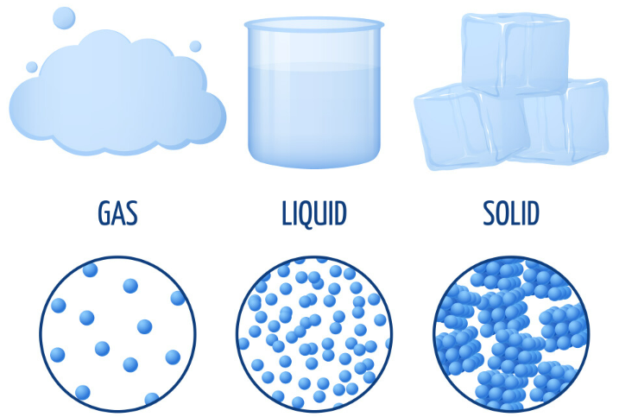
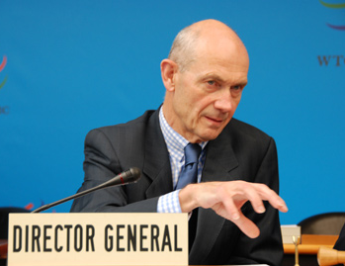
Global Policymaking & the Three States of Matter
To understand the sometimes vaporous quality of the WTO’s functions and powers one needs to consider the complicating factors of sovereignty (which national governments are not eager to surrender), coherence (which becomes a problem in the presence of numerous international organizations), and the WTO members’ penchant for constructive ambiguity (which helps to set new rules but may undermine their enforcement).
These problems are only worsened when leadership is in decline, and when countries favor their defensive over their offensive interests.

Slide 18
Some Common Misperceptions
It is not the case that ―
The WTO per se has interests and goals
All WTO agreements are unambiguous and comprehensive
International law is part of a hierarchy in which global rules overrule the national rules
The dispute-settlement procedures ensure that any WTO-inconsistent measures are automatically nullified
A member-driven organization
Constructive ambiguity
Monistic vs. dualistic legal systems
A difference between the norm and the rule

Slide 19
The Rules of the System
The WTO per se has no existence independent of its members, and its rules are not the rules …
— But instead —
… they are rules about rules. The real rules are the national laws that fall within the range of permissible practices set by the WTO rules.

Slide 20
WTO Rules and “Policy Space” (or “Wiggle Room”)
Think of this as the difference between a point and a box. Trade agreements are more about defining the size and shape of the box than specifying the precise point that countries will choose to occupy.
The rules of the WTO and the commitments that countries make are best seen not as precise requirements, but as parameters that set limits on the range of countries’ freedom of movement.

Slide 21
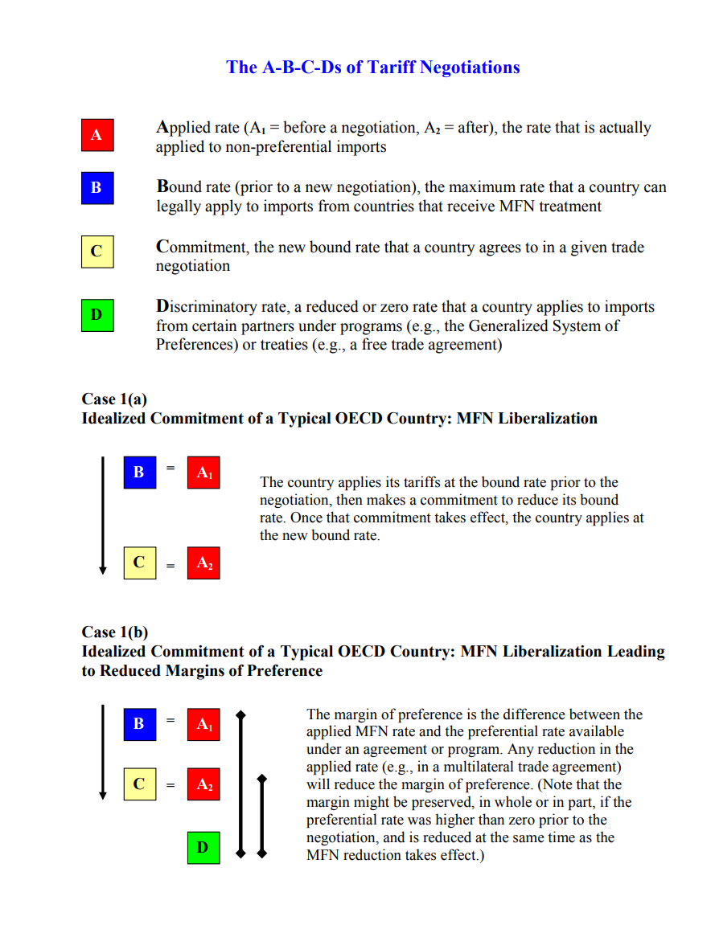
A Simple Example: Tariffs
Suppose that Country A has made a binding of 10% for its tariff on pencils. Does that mean that henceforth its tariff on pencils will in fact be 10%?

Slide 22
Two Rules, Many Exceptions
At the core of the system are two simple rules of non-discrimination (supplemented by many detailed ones), namely GATT Article I (MFN) and GATT Article III (national treatment).
— But —
A lot of GATT 1947, and much of the subsequent agreements, consist of exceptions to the core rules.

Slide 23
Discrimination
The central objectives of the GATT 1947 were to reduce the levels of protection and discrimination. — But — The overall levels of protection are far lower today, and WTO membership is nearly universal, but the degree of discrimination may be higher than ever.

