Slide 1
Corruption, political stability and illicit financial outflows in Sub-Saharan Africa
EMMANUEL ORKOH
aorkoh@gmail.com
CARIKE CLAASSEN
carike.claassen@nwu.ac.za
DERICK BLAAUW
derick.blaauw@nwu.ac.za
Trade Research Focus Area
Faculty of Economic and Management Sciences
North-West University

Slide 2
Outline of the presentation
Introduction and objective
Methodology and data
The empirical estimation strategy
Results and discussions
Policy recommendations

Slide 3
Introduction and objective
The African Union introduced Agenda 2063 in 2015 to serve as a roadmap to a transformed African continent within the next 50 years.
It calls for prompt action to strengthen domestic resource mobilisation, build continental capital markets and financial institutions, and reverse the illicit flows of capital from the continent (AU, 2015a:18).
The focus on illicit capital flows is warranted, with Global Financial Integrity (GFI) estimating in 2013 that Africa is a net creditor to the world, even after financial flows such as FDI, debt forgiveness and remittances have been taken into account.
A special issue of the African Development Review (ADR) (2016) delves into these issues at length.

Slide 4
Introduction and objective continued
According the African Union’s (2015b:13) high-level panel on illicit financial flows, illicit financial flows cost the continent $50 billion annually.
S$511 billion being lost to capital flight between 2000 and 2010 as opposed to half that amount in the previous decade.
Between 2000 and 2010, if African countries had managed to retain capital lost to illicit flows and invest it in domestic economies, additional economic growth rates of as high as 3 per cent could have been achieved (Ndikumana, 2014).
Research into capital flight in Africa has focused on its determinants and possible impacts.

Slide 5
Introduction and objective continued
This paper contributes to the debate by examining the effect of corruption control and political stability on illicit financial outflows in Sub-Saharan Africa.
The importance of good institutions and political stability were highlighted throughout the ADR’s special issue as key drivers of capital flight in individual African countries.
Trade misinvoicing especially in the natural resource sector is identified as an important channel of capital flight (Mpenya, Metseyem & Epo, 2016; Kwaramba et al., 2016).
This article makes a specific contribution to the debate by looking at trade misinvoicing and Leakages in Balance of Payment (BOP) as sources of illicit financial outflows.

Slide 6
Methodology and data
The empirical analyses is based on a balanced panel data built from three sources: 1) the World Bank, 2) United Nations Conference on Trade and Development (UNCTAD), and 3) Global Financial Integrity (GFI).
Political stability and control of corruption were extracted from the World Governance Indicators of the World Bank.
Political stability and absence of violence/terrorism measures perceptions of the likelihood of political instability and/or politically-motivated violence, including terrorism(World Bank, 2017).
Control of corruption captures perceptions of the extent to which public power is exercised for private gain, including both petty and grand forms of corruption, as well as "capture" of the state by elites and private interests (World Bank, 2017)

Slide 7
Methodology and data cont..
Inflation (CPI) and exchange (calculated as an annual average based on monthly averages) from the World Bank’s WDI while FDI inflows (measured in millions of dollars) were obtained from the UNCTAD.
Illicit financial flows (IFFs) from Global Financial Integrity (GFI).
Illicit financial flows stem from two sources:
Deliberate misinvoicing in merchandise trade (the source of GFI’s low and high estimates).
Leakages in the balance of payments (also known as “hot money flows”).
Comparing the two sources, trade misinvoicing is the primary measurable means by which organisations and individuals shift funds in and out of developing countries illicitly (Global Financial Integrity, 2017).

Slide 8
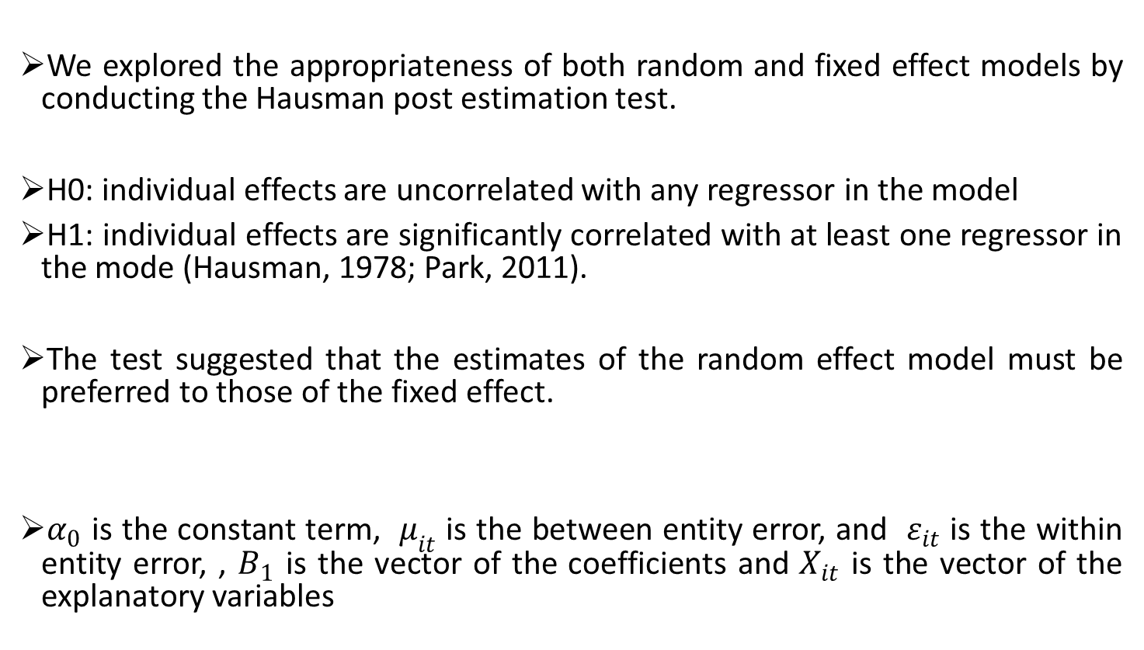
Empirical estimation strategy
We explored the appropriateness of both random and fixed effect models by conducting the Hausman post estimation test.
H0: individual effects are uncorrelated with any regressor in the model
H1: individual effects are significantly correlated with at least one regressor in the mode (Hausman, 1978; Park, 2011).
The test suggested that the estimates of the random effect model must be preferred to those of the fixed effect.
$α_{0}$ is the constant term, $μ_{it}$ is the between entity error, and $ε_{it}$ is the within entity error, , $B_{1}$ is the vector of the coefficients and $X_{it}$ is the vector of the explanatory variables
$Y_{it}=B_{1}X_{it}+α_{0}+μ_{it}+ε_{it}$ (1)

Slide 9
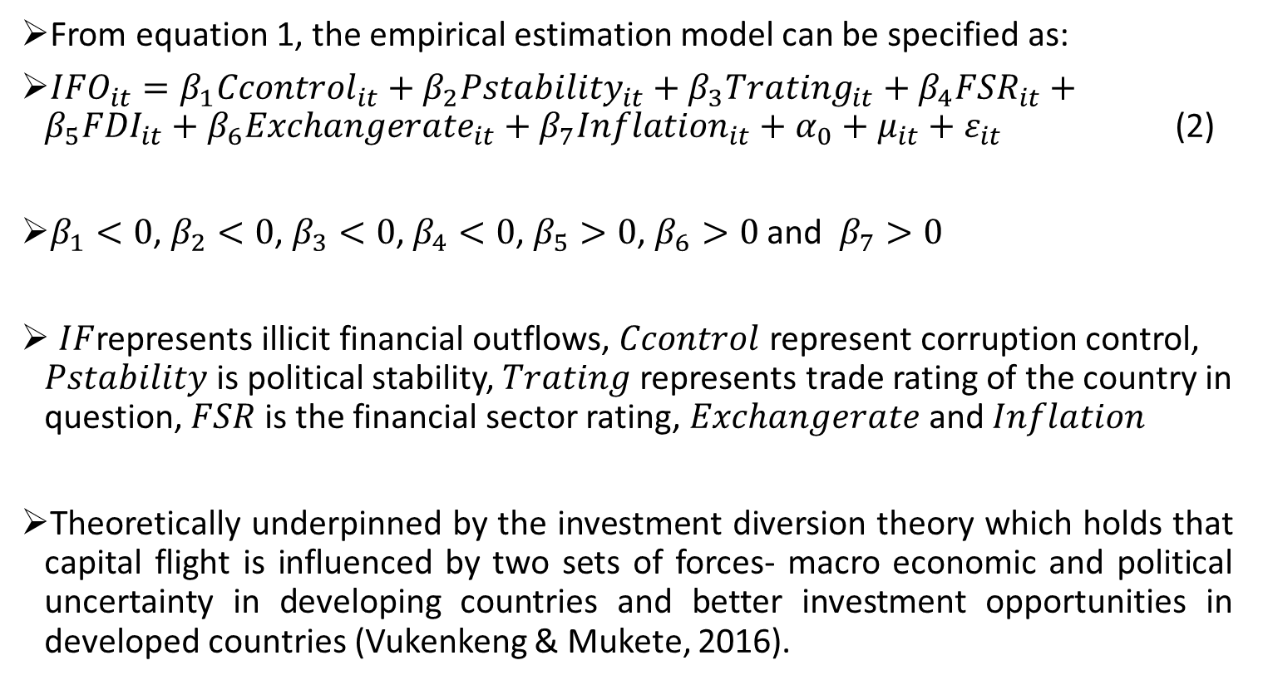
Empirical estimation strategy cont…..
From equation 1, the empirical estimation model can be specified as:
${IFO}_{it}=β_{1}{Ccontrol}_{it}+β_{2}{Pstability}_{it}+β_{3}{Trating}_{it}+β_{4}{FSR}_{it}+β_{5}{FDI}_{it}+β_{6}{Exchangerate}_{it}+β_{7}{Inflation}_{it}+α_{0}+μ_{it}+ε_{it}$ (2)
$β_{1}<0$, $β_{2}<0$, $β_{3}<0$, $β_{4}<0$, $β_{5}>0$, $β_{6}>0$ and $β_{7}>0$
$IF$represents illicit financial outflows, $Ccontrol$ represent corruption control, $Pstability$ is political stability, $Trating$ represents trade rating of the country in question, $FSR$ is the financial sector rating, $Exchangerate$ and $Inflation$
Theoretically underpinned by the investment diversion theory which holds that capital flight is influenced by two sets of forces- macro economic and political uncertainty in developing countries and better investment opportunities in developed countries (Vukenkeng & Mukete, 2016).

Slide 10
Results and discussion
Illicit outflows are very high in countries such as Niger, Sudan, Sierra Leon and Nigeria but very low in Central African Republic, Eretria, and Guinea Bissau.
Nigeria recorded the highest average amount of illicit financial outflows (US$ 17855.95 million), followed by Sudan (US$ 8905.085 million), Ethiopia (US$ 2205.775 million) while Benin (US$ 180.8223 million), Comoros (US$ 44.2375 million), and Central African Republic (US$ 29.7536 million) had lowest amount between 2005-2015.
Illicit financial outflows increased from 2004 to 2008 before decreasing between 2008 and 2010. However, from 2010 to 2014, the trend was alternating between the years.
The upper estimates (10 percent high) peaked to as high as US$ 1890 million on average in 2008 but reduced to the lowest (US$1100) in 2012.
Although illicit financial outflow due to misinvoicing of merchandise trade has reduced since 2013, it still remains high at an average of about US$ 900 million in 2014.
Between 2006 and 2009, illicit financial outflows increased when corruption control and political stability were low.
Similar phenomenon was observed between 2011 and 2014.

Slide 11
Results and discussion cont….
Figure 1: Misinvoicing in merchandise trade, political stability and corruption control.

Slide 12
Results and discussion cont….
Figure 2: Control of corruption and misinvoicing in merchandise trade by country
Figure 3: Political stability and misinvoicing in merchandise trade by country

Slide 13
Results and discussion cont….
Estimates of 10 percent high of outflows
At 1 percent level of significance, 1 percent increase in the corruption control score of a country reduces illicit financial outflows by about 1.5 percent which is equivalent to about US$ 36 million.
Similarly, a unit increase in the political stability score of a country reduces illicit financial outflows by about 1.3 percent (US$ 53 million).
Estimates of illicit financial outflows (10 percent low)
At 1 percent level of significance, an increase in a country’s score of its political stability by 1 percent is associated with a reduction in illicit financial outflows by about 1.6 percent (US$ 36 million).
Insignificant effect of corruption control on 10 percent low of illicit financial outflows in Sub-Saharan Africa although the intuition signs are correctly observed.

Slide 14
Results and discussion cont….
Table 3: Estimates of illicit financial outflows (10 percent high and low)
The effects of political stability and corruption control on the average 10 percent high and 10 percent low of illicit financial outflows are 1.25 percent (US$ 20.48 million) and 1.29 percent (US$ 44.26 million) respectively.
Table 4: Illicit financial outflow due to leakage in BOP (10 percent high)
Corruption control (0.943% equivalent to US$ 32.23 mil ) at 1 percent level of significance
Corruption control (3.04% equivalent to US$ 48.13 mil ) at 1 percent level of significance.
Illicit financial outflow due leakage in BOP (10 percent low)
Corruption control (0.211% equivalent to US$3.664 mil).

Slide 15
Results and discussion cont….
Political stability (2.59% equivalent to US$10.39 mil).
Illicit financial outflow due leakage in BOP (10 percent low)
Corruption control (0.943% equivalent to US$ 32.23 mil ) at 1 percent level of significance
Corruption control (3.04% equivalent to US$ 48.13 mil ) at 1 percent level of significance.
Other control variables
High trade rating, financial sector rating and exchange rates reduce illicit financial outflows while increase in foreign direct investment and inflation increase illicit financial outflow

Slide 16
Policy recommendation
Governments in Sub-Saharan Africa countries must ensure that institutions responsible for fighting corruption and enhancing stable governance are well empowered and given the needed resources to work effectively to reduce corruption to the barest minimum
More than lip service to good institutions is vital if the continent is to achieve the Agenda 2063 goals of a transformed African continent within the next 50 years.
Thank you

Slide 17
Regression estimates

Slide 18
Regression estimates cont…..

Slide 19
Results and discussion continued

Slide 20
Regression estimates cont…

Slide 21
Regression estimates cont…

Slide 22
Regression estimates cont…

